Slide 1
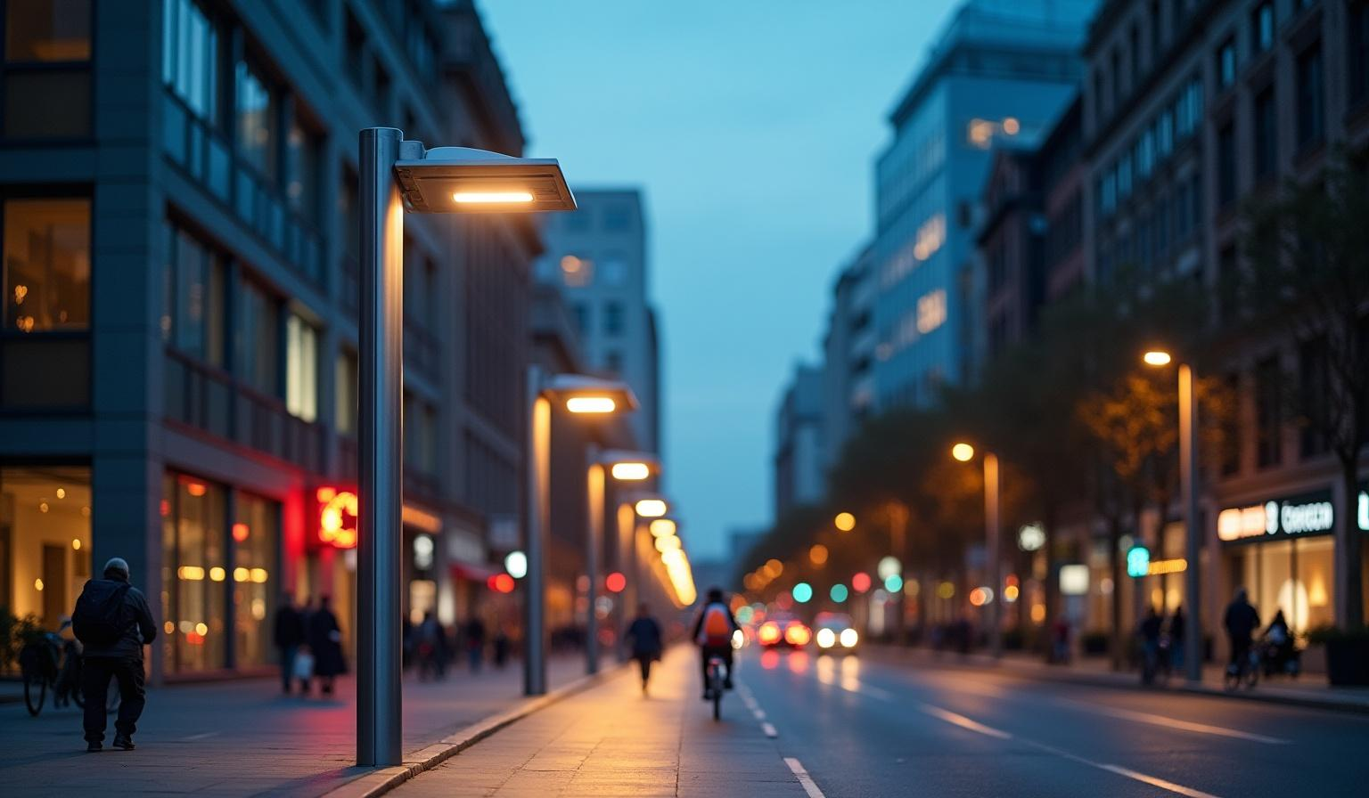
Automated smart lighting system
Innovative Urban Lighting Solutions

Slide 2
Introduction
This presentation explores the development and implementation of smart street light systems utilizing an Arduino platform. It encapsulates essential components such as PIR sensors, LED lights, buzzers, LCD displays, and how these elements work together to enhance urban infrastructure, energy efficiency, and safety.

Slide 3
Components Used in the System
This system comprises several key components:
- Arduino for control and programming,
-PIR sensors for motion detection,
- LED lights for efficient illumination.
Together, they create a responsive and intelligent lighting system.

Slide 4
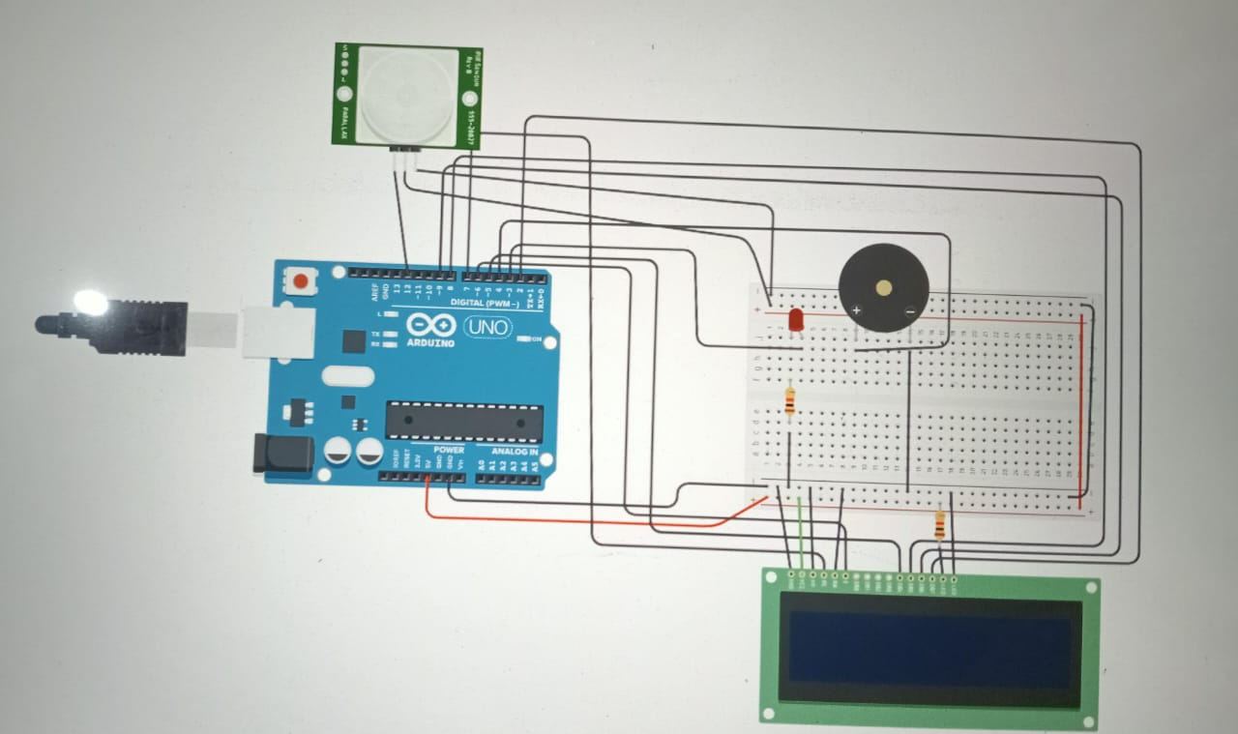
CIRCUIT DIAGRAM

Slide 5

Arduino Code

Slide 6
Working Principle
The system operates using a PIR (Passive Infrared) sensor, which detects infrared radiation (heat) emitted by moving objects like humans. When motion is
detected:
-The PIR sensor sends a signal to the microcontroller (e.g., Arduino).
-The microcontroller processes the signal and activates a relay or directly
-powers an LED/light.
If no motion is detected for a specific duration, the microcontroller turns the
light off.

Slide 7

05
Applications

Slide 8
Smart Traffic Management
Smart street lights enhance traffic management by adjusting light levels based on real-time road conditions.
This capability reduces congestion and improves flow, making streets safer for drivers and pedestrians alike.

Slide 9
Energy Conservation
The energy-saving potential of smart street lights benefits municipalities economically.
By utilizing LED technology and responsive lighting, cities can significantly decrease their energy consumption and carbon emissions.

Slide 10
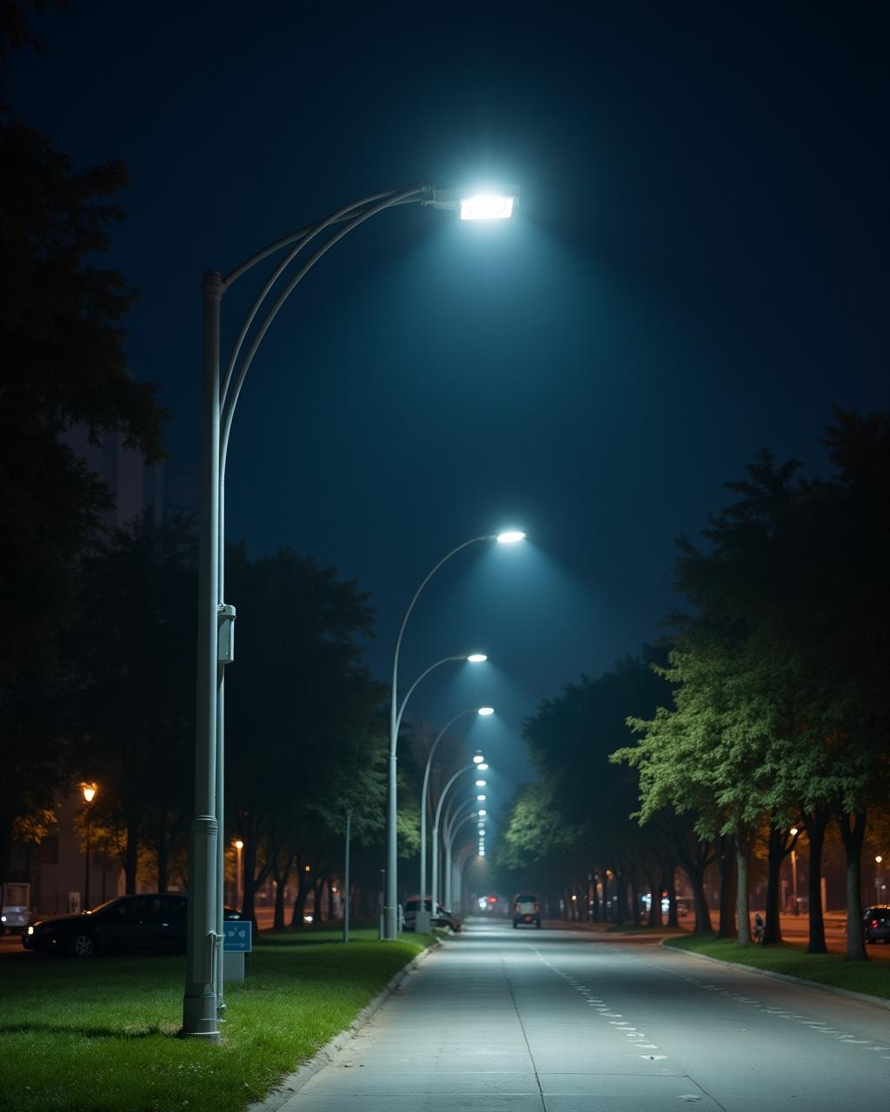
Enhancing Public Safety
These smart systems contribute to public safety by illuminating areas only when necessary, deterring crime and enhancing visibility during nighttime hours.
The responsive nature of the lights fosters a safer urban environment for all.

Slide 11
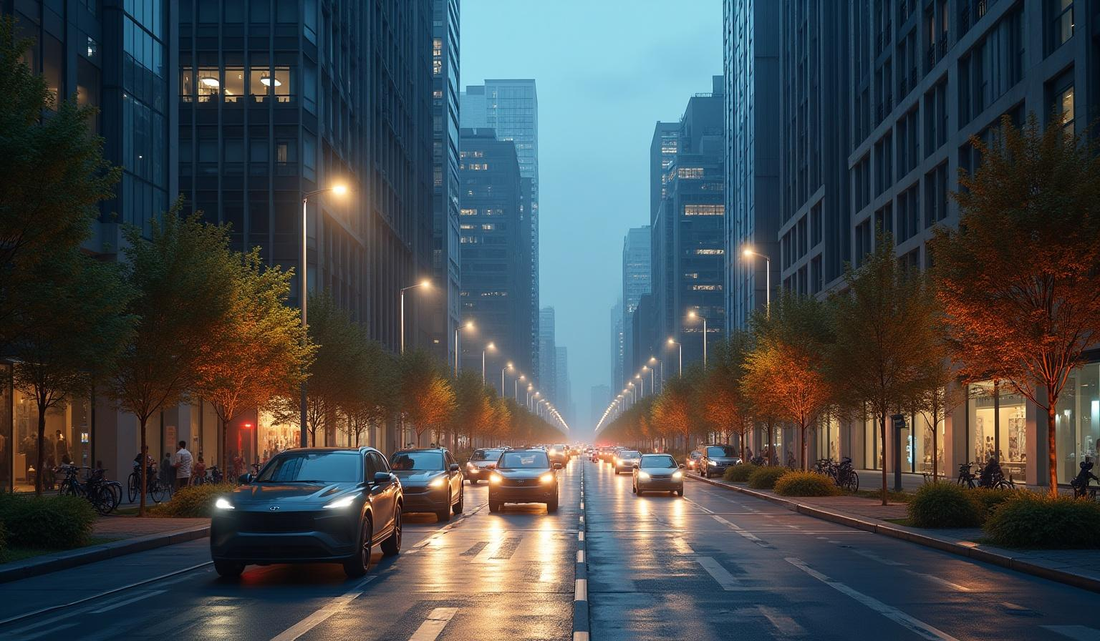
06
Future Scope

Slide 12

Expansion in Urban Areas
The future of smart street lights involves wider implementation in urban areas.
As cities expand, the adoption of intelligent lighting solutions will be critical to support sustainability and energy resilience.

Slide 13
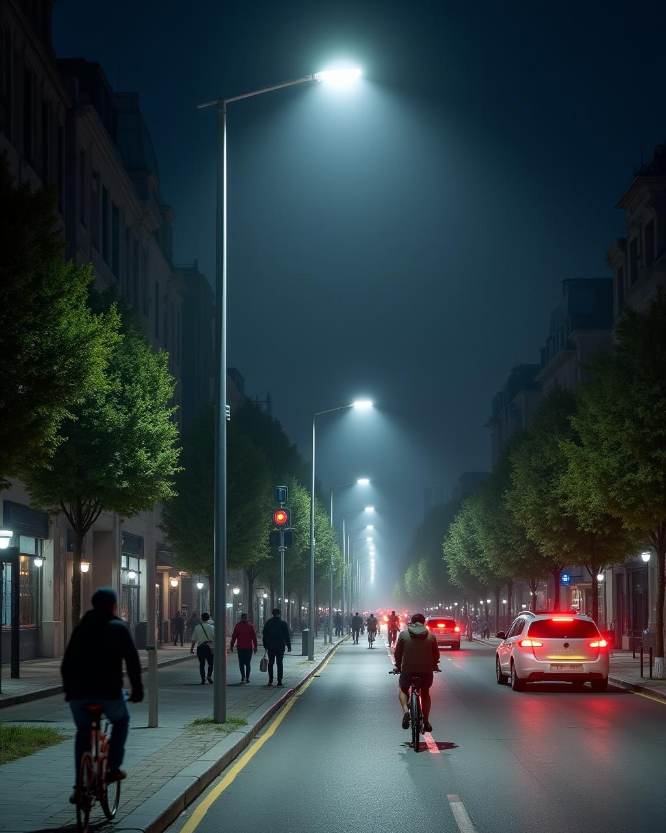
Conclusions
The development of smart street light systems is vital in modern urban planning.
By combining innovative technologies, cities can improve energy efficiency, enhance public safety, and actively manage traffic flow.
The future of this technology shows promising advancements and significant urban applications.

Slide 14
Thank You !

